Slide 1
NETWORK FLOW ANALYSIS
USING BIG DATA

Slide 2
CONTENTS
Pre-Requisite Phase (May – June)
Understanding Phase (June – July)
Building Phase (July – August)

Slide 3
PRE-REQUISITE PHASE
Net Flow
Flow Tool
Hadoop Setup

Slide 4
NET FLOW
A feature that was introduced on Cisco routers that gives the ability to collect IP network traffic as it enters or exits an interface.
Consists of three components: flow caching, Flow Collector, and Data Analyzer.
Creates an environment where administrators have the tools to understand who, what, when, where, and how network traffic is flowing.
There are two primary methods for accessing the data: Command Line Interface, Net Flow collector.

Slide 5
IP PACKET ATTRIBUTES
IP source address
IP destination address
Source port
Destination port
Layer 3 protocol type
Class of Service
Router or switch interface

Slide 6
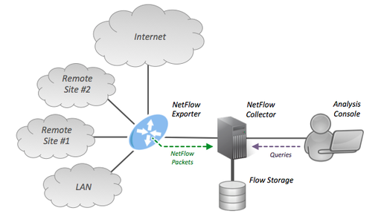

Slide 7
FLOW TOOL
It is a library and a collection of programs used to collect, send, process, and generate reports from Flow data.
Can be used together on a single computer or server or distributed to multiple servers for large deployments.
Flows are exported from a router in a number of different configurable versions. A flow is a collection of key fields and additional data.
Some of the commands include flow-capture, flow-cat, flow-report.

Slide 8
HADOOP - SETUP
Installing JDK on Linux
Creating a dedicated Hadoop user
SSH: Secure Shell
Disabling IPV6
Hadoop Config. files
Running Hadoop

Slide 9
PHASE I: CONCLUSION
Understanding of different tools.
Read and understood about the different tools available for Network flow collection.
Setup a Single Node Hadoop cluster

Slide 10
UNDERSTANDING PHASE
Big Data – Overview
Hadoop Framework
Botnet Detection
Detecting DDoS Attacks with Hadoop
Brute-Force Attacks Detection
TCP Flow Analysis for Defense against Shrew DDoS Attacks

Slide 11
BIG DATA – OVERVIEW
90% of the data in the world today has been created in the last two years alone.
The term Big Data refers to large-scale information management and analysis technologies that exceed the capability of traditional data processing technologies.
Big Data Analytics is a paradigm where large data sets are split into small ones and given to worker nodes to compute and all the results are appended to give the result.

Slide 12
ADVANTAGES OF BIG DATA ANALYTICS
Advantages over traditional technologies –
Can handle data with variety, velocity and volume can be managed easily.
Other Factors pushing towards this new technology-
rapidly decreasing cost of storage and CPU power in recent years.
flexibility and cost-effectiveness of datacenters and cloud computing for elastic computation and storage.
development of new frameworks such as Hadoop, allowing distributed computing systems to store large quantities of data through flexible parallel processing.

Slide 13
HADOOP
Hadoop is an Open-source framework which allows developers to take advantage of Map-Reduce Paradigm which involves very large and different sets of data.
Hadoop is one of the most popular technologies for batch processing. It lets user to define the formats according to their needs and analyze the data.
Several tools can help analysts create complex queries and run machine learning algorithms on top of Hadoop.
Applications
Big Data analytics can be leveraged to improve information security and situational awareness. For example, Big Data analytics can be employed to analyze financial transactions, log files, and network traffic to identify anomalies and suspicious activities.

Slide 14
NEED FOR BIG DATA
With development of new technology and devices, rate of collection of data is increasing very rapidly. The volume of business data worldwide, across all companies, doubles every 1.2 years, according to estimates.
Large Hadron Collider experiments - 150 million sensors delivering data 40 million times per second
Square Kilometer Array is a telescope which consists of millions of antennas - expected to gather 14 exa- bytes and store one petabyte per day.
eBay.com uses two data warehouses at 7.5 petabytes and 40PB as well as a 40PB Hadoop cluster
Walmart handles more than 1 million customer transactions every hour
Handling such large databases, datasets and queries is impossible using traditional technologies. This is where Big data is way ahead of other technologies.

Slide 15
BOTNETS
A botnet is a network of compromised hosts (bots) which are controlled by an attacker also called the botmaster. The botmaster sends commands via a C&C (Command and Control) channel.
The current botnets are based on peer to-peer technologies where each bot acts as a client and a server.
Problems in detecting botnets
Nowadays, botnet traffic is mixed with a huge volume of benign traffic due to almost ubiquitous high speed networks. Such networks can be monitored using IP flow records but their forensic analysis form the major computational bottleneck.

Slide 16
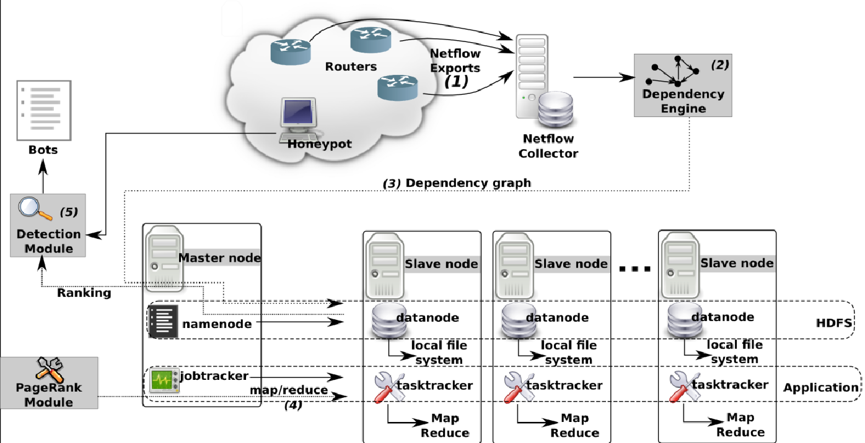
BOTNET FRAMEWORK

Slide 17
DETECTING DDOS ATTACKS WITH HADOOP
Recent distributed denial-of-service (DDoS) attacks have demonstrated horrible destructive power by paralyzing web servers within short time.
As the volume of Internet traffic rapidly grows up, the current DDoS detection technologies have met a new challenge that should efficiently deal with a huge amount of traffic within the affordable response time.
Main Idea.
Counter-based detection is a simple method that counts the total traffic volume or the number of web page requests. Since the DDoS attack with the low volume of traffic such as the HTTP GET incomplete attack is prevalent these days, the frequency of page requests from clients will be a more effective factor.

Slide 18
DETECTING DDOS ATTACKS WITH HADOOP
Actual Algorithm
In the MapReduce algorithm, the map function filters non-HTTP GET packets and generates key values of server IP address, masked timestamp, and client IP address.
The reduce function summarizes the number of URL requests, page requests, and server response between a client and a server.
Finally, the algorithm aggregates values per server. When total requests for a specific server exceeds the threshold, the records are marked as attackers.

Slide 19
BRUTE-FORCE ATTACKS
Brute-force attacks are getting harder to successfully detect on a network level due to increasing volume and encryption of network traffic and growing ubiquity of high-speed networks.
Analyse current methods for detection of brute-force attacks based on the analysis of network flows and discusses their strengths and shortcomings.
Attacks in general can be divided into two categories depending on their impact on traffic patterns.
noisy attacks that disrupt these patterns significantly.
stealthy attacks that are much harder to gather and examine as they, by virtue try to remain undetected.

Slide 20
BRUTE-FORCE ATTACKS
Since a lot of network traffic is encrypted, the traditional approach to network-based intrusion detection is becoming ineffective as only Packet headers can be analysed instead of Payload.
How to defend?
describe how it is possible to use network flows to discover anomalies and intrusions.
Brute-force attacks are most frequently detected at the host level by inspecting access logs.
If the predefined number of unsuccessful login attempts is reached, an alert is fired, the attacker blocked or other attempts significantly delayed. This approach is effective, even for distributed attacks.

Slide 21
BRUTE-FORCE ATTACKS
Downfalls of Network flows for Detection
When network traffic is converted to network flows, information like the packet payload, is lost. This loss of information implies that network flows are not suitable for the detection of all kinds of malicious network activity.
The acquired flows are sent at least with a 5-minute delay which could be considered too late in case of attack which happen very fast.

Slide 22
BUILDING PHASE
Word Count - Single Node Cluster
Multi Node Cluster Setup
Packet Count Program
Current measures for Detecting DDoS
Our Approach

Slide 23
WORD COUNT - SINGLE NODE
Word count is a typical example for checking the usage of Hadoop which is intended to count the no of occurrences of each word in the provided input files.
Implemented in two stages: Mapper and Reducer
In Mapper phase, the text is tokenized into words and then a key value pair is formed with these words where the key being the word itself and value ‘1’.
In the Reducer phase the keys are grouped together and the values for similar keys are added. This would give the number of occurrence of each word in the input.

Slide 24
WORD COUNT IN DETAIL
Input Files
Mapper Phase
Reducer Phase
Batman Superman Ironman
Batman-1 Superman-1 Ironman-1
Batman -3 Superman-2 Ironman-2
Flash-1
Hulk-1
Batman Superman Flash
Batman-1 Superman-1
Flash-1
Hulk Batman Ironman
Hulk -1
Batman-1
Ironman-1

Slide 25
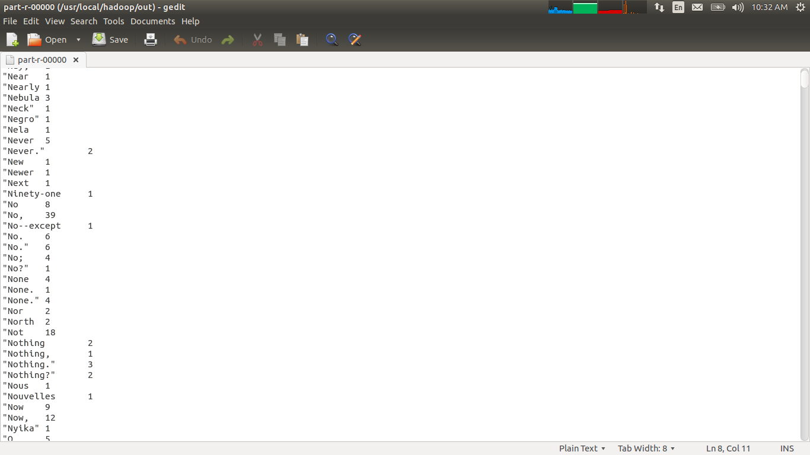
EXAMPLE

Slide 26
MULTI NODE CLUSTER SETUP
We built a multi-node cluster using four Ubuntu boxes which are initially configured with the single node Hadoop cluster .
These are merged together in which one Ubuntu box will become the master and the rest slaves.
Master (Name Node):
manages the file system namespace operations like opening, closing, and renaming files and directories.
determines the mapping of blocks to Data Nodes along with regulating access to files by clients.
Slaves (Data Nodes):
responsible for serving read and write requests from the file system’s clients.
perform block creation, deletion, and replication upon instruction from the Master.

Slide 27
CONFIGURATION
Data Node
Master
Secondary Name Node
Name Node
Resource Manager
Slave1
Slave2
Slave3
Data Node
Node Manager
Data Node
Node Manager
Data Node
Node Manager

Slide 28
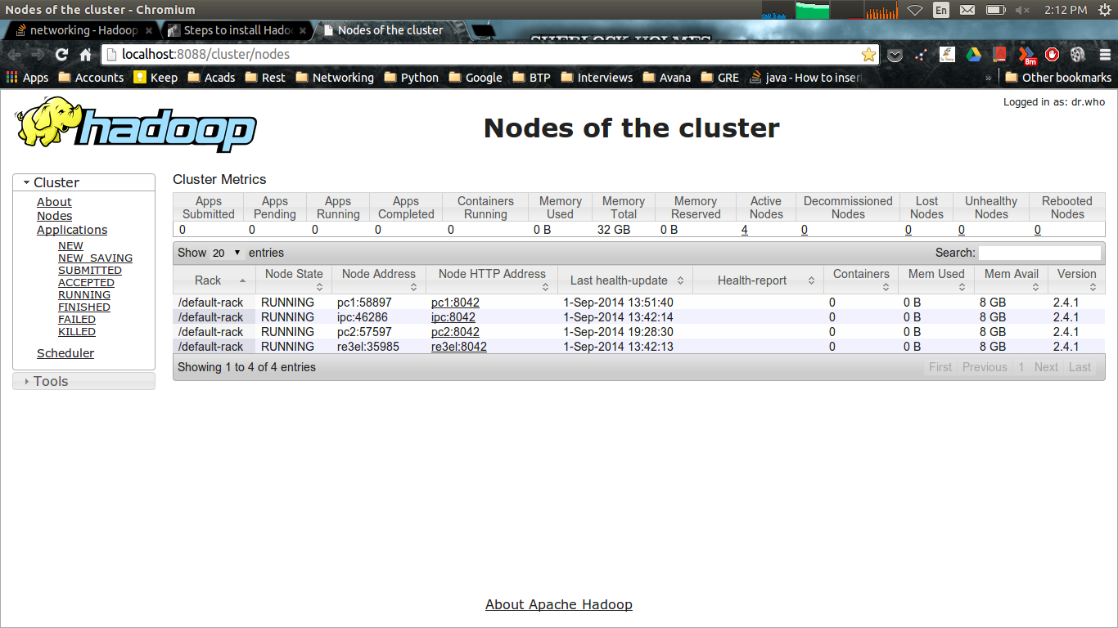
WEB UI

Slide 29
PACKET COUNT PROGRAM
Using Hadoop’s MapReduce paradigm, we were able to count number of packets from different IP Sources.
Method:
Capture packets and store them in .pcap file.
Run PacketCount program by giving .pcap file as an input.
Output is sorted Source IP Addresses with no. of packets sent to the host in that period.

Slide 30
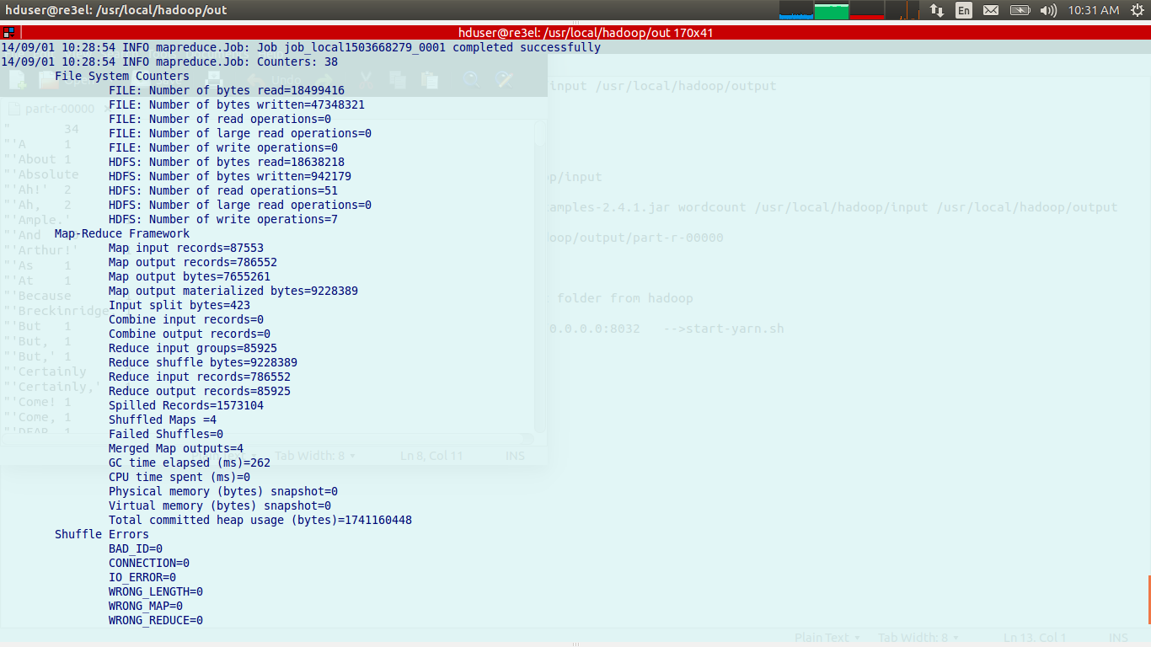
SAMPLE RESULT

Slide 31
DDOS ATTACK TYPES
Attacks Targeting Network Resources
UDP Flood
ICMP Flood
IGMP Flood
Attacks Targeting Server Resources (stateful devices such as firewalls and IPSs as well)
TCP SYN Flood
TCP RST Attack
TCP PSH+ACK Flood
Attacks Targeting Application Resources
HTTP Flood
DNS Flood

Slide 32
DDOS ATTACK MITIGATION
For Web or Application-based attacks
• Access rate over time - This identifies access rate to the application during different hours and days of the week
• Rate per application resource - access rate for an application login page is greater than for other pages in the application.
• Response latency - The application response latency for each application resource (and for the entire application) indicates when a resource is being exhausted.
• Rate of application responses - The rate of application responses such as 404 (page not found errors) and 500 (application errors) will change according to how the application is used.
• Geographical locations - User access rate can be segregated according to the users’ geographical location.

Slide 33
OUR APPROACH
Statistical Analysis
The map function alters non-HTTP GET packets and generates key values of server IP address, masked timestamp, and client IP address. The reduce function summarizes the number of URL requests, page requests, and server response between a client and a server.
Finally, the algorithm aggregates values per server. When total requests for a specific server exceeds the threshold, the records are marked as attackers.
Hop Count Method
Each packet has a TTL (Time to live) value. Whenever it passes through a router, TTL value is reduced by 1. In this method, we store a table with IP- hop count entries. We ping recently contacted IP Addresses regularly and record how many hops packets take. When a packet enters our network, we check its hop count entry.

Slide 34
FUTURE WORK
Implementation of new methods to mitigate DDoS attacks using MapReduce.
We also would try to analyze the packets and calculate statistics.

